Slide 1
Explainable deep learning models for Classification of Ventriculomegaly using Fetal Brain MRI Images
Team Number:CB1
AMENU4CSE20163 : SHOAIB AKHTAR
AMENU4CSE20222 : DEVU PAWAN ASHUTOSH
AMENU4CSE20225 : G YESHWANTH REDDY
AMENU4CSE20232 : HARDIK KUMAR SINGH
Guide : Dr. Simi S.
Amrita School of Computing | Amrita Vishwa Vidyapeetham | Amritapuri

Slide 2
Introduction
Ventriculomegaly involves enlarged brain ventricles, fluid-filled cavities responsible for cerebrospinal fluid production.
Accurate diagnosis of mild cases is challenging, leading to potential false positives and negatives.
Experienced radiologists may make unforced errors in identifying ventriculomegaly.
The project aims to reduce false positives and negatives associated with ventriculomegaly diagnoses.
Enhancing diagnostic precision is crucial for improved medical assessment and patient care.

Slide 3
Motivation
Early detection of ventriculomegaly enables timely intervention and treatment.
Routine ultrasound reveals mild enlargement of a baby's lateral ventricles, prompting uncertainty in diagnosis.
An explainable deep learning model assists the radiologist by highlighting specific features predictive of ventriculomegaly.
The model predicts a high risk of ventriculomegaly, aiding in a more accurate and timely diagnosis.
Improved diagnostic precision through the model enhances outcomes for the baby and the family.

Slide 4
Background Study/Related Work
Title &year | Problem | Contributions | Limitations | Open problems/Future work
Using deep‐learning algorithms to classify fetal brain ultrasound images as normal or abnormal Year - 2020 | Fetal ventriculomegaly is a condition in which the lateral ventricles of the brain are enlarged. It can be challenging to accurately diagnose ventriculomegaly. Develop explainable deep learning models that can accurately and classify fetal ventriculomegaly from ultrasound images. | The authors propose a deep learning method to classify fetal brain ultrasound images as normal or abnormal. Their method is based on a convolutional neural network. The authors trained their CNN on a dataset of over 29,000 fetal brain ultrasound images. Their method achieved an accuracy of 96.3%. | It was conducted on a single-center dataset. This means that the method may not perform as well on data from other medical centers. the method does not yet support other diagnostic planes. | Future work should focus on developing multicenter datasets and expanding the algorithm to support other diagnostic planes. Investigate the use of transfer learning to improve the performance of the model on multicenter datasets.
Explainable Deep Learning for Fetal Brain Ventriculomegaly Classification Year - 2021 | Develop an explainable deep learning model that can accurately and reliably classify fetal brain ventriculomegaly from ultrasound images, while also providing insights into its predictions. This model could be used to improve the accuracy and reliability of diagnosis, and to help clinicians make better decisions about the care of their patients. | The authors evaluated their model on a held-out test set of over 2,500 images. Their model achieved an accuracy of 97.3%. The authors also evaluated the explainability of their model. They found that the model was able to provide accurate and informative explanations for its predictions. | it was conducted on a single-center dataset. This means that the model may not perform as well on data from other medical centers. It is not trained to classify other fetal brain abnormalities | Investigate the use of transfer learning to improve the performance of the model on multicenter datasets. Develop a method to evaluate the explainability of the model on real-world clinical data. Develop a prototype system that can be used by clinicians in a clinical setting.

Slide 5
Background Study/Related Work
Title &year | Problem | Contributions | Limitations | Open problems/Future work
Fetal Ventriculomegaly and Hydrocephalus What Shouldn't be Missed on Imaging Year - 2021 | Developing an accurate and reliable deep learning model for the classification of fetal brain ventriculomegaly from ultrasound images However, existing deep learning models are often complex and difficult to interpret, making it difficult for clinicians to understand why the model makes the predictions that it does. | The authors highlight the importance of using a standardized approach to measuring the lateral ventricles on ultrasound images. The authors discuss the various differential diagnoses of fetal ventriculomegaly, including choroid plexus cysts, Dandy-Walker malformation, and Chiari II malformation. | The paper is focused on imaging findings, so it does not discuss the clinical aspects of fetal ventriculomegaly in detail. It does not discuss the challenges of diagnosing fetal ventriculomegaly in preterm fetuses and fetuses with multiple gestation. | Develop new imaging techniques for the diagnosis and assessment of fetal ventriculomegaly, such as diffusion tensor imaging (DTI) and tractography. Develop explainable deep learning models that can provide insights into their predictions
U-Net and Its Variants for Medical Image Segmentation: A Review of Theory and Applications Year - 2021 | Medical image segmentation is the task of identifying and labeling different anatomical structures in medical images. This task is essential. However, manual image segmentation is time-consuming and labor-intensive, and it can be difficult to achieve high accuracy and reproducibility. | U-Net models can generalize well to new data. They can segment small and rare lesions, which can be difficult to segment using traditional methods. U-Net models can be used to segment multiple anatomical structures simultaneously. | The paper is a review article, so it does not present any new original research. Additionally, the paper does not discuss the limitations of U-Net such as its sensitivity to hyperparameters and their need for large amounts of training data. | Develop U-Net variants that are more explainable, so that clinicians can better understand why the model makes the predictions that it does. It that can be used to segment multiple anatomical structures simultaneously.

Slide 6
Background Study/Related Work
Title &year | Problem | Contributions | Limitations | Open problems/Future work
Detecting and Classifying Fetal Brain Abnormalities Using Machine Learning Techniques Year - 2018 | Fetal brain abnormalities can have serious consequences for the development and well-being of the child. Early detection and diagnosis of these abnormalities is essential for ensuring the best possible outcomes. However, traditional methods of fetal brain imaging, such as ultrasound, can be difficult to interpret, and even experienced radiologists can make mistakes. | The paper proposes a machine learning method for detecting and classifying fetal brain abnormalities using ultrasound images. The method is based on a convolutional neural network. The authors trained their CNN on a dataset of near to 30,000 fetal brain ultrasound images, including both normal and abnormal images. The images were collected from a single medical center. | The method was trained on a single-center dataset. This means that the method may not perform as well on data from other medical centers. The method does not yet support other diagnostic planes. In addition to the axial plane, fetal brain ultrasounds are also acquired in the coronal and sagittal planes. | In addition, future work could investigate the use of transfer learning to improve the performance of the model on multicenter datasets. Finally, future work could evaluate the method on a dataset of fetal brain ultrasound images with a wider range of abnormalities, such as microcephaly, encephalocele, and agenesis of the corpus callosum.

Slide 7
Project Contributions
Automated Ventriculomegaly Classification:
Objective: Develop a deep learning system for ventriculomegaly classification using human brain MRI images.
Outcome: High accuracy and sensitivity in early-stage detection, facilitating timely intervention and treatment. Automating classification enhances efficiency and precision.
Explainable AI (XAI) for Interpretability:
Objective: Integrate Explainable AI (XAI) models to enhance result interpretability.
Outcome: Models like LIME provide transparent explanations for classification decisions, ensuring human-understandable insights. Interpretability aids clinician trust and validation, crucial for diagnosis and treatment planning.

Slide 8
Improvements Based on First Review(If any)
Q) What was the team's response to the initial feedback during the first review?
A) The team decided to shift focus from classification and segmentation to implementing Explainable AI (XAI) based on the feedback.
Q) What approach did the team take after the shift in focus?
A) The team implemented a basic yet efficient CNN model for classification and initiated the implementation of two XAI models: LIME (Local Interpretable Model-Agnostic Explanations) and GRADCAM (Gradient-weighted Class Activation Mapping).

Slide 9
Progress After First Review
XAI Integration with CNN:
Implemented XAI on the CNN model to understand why certain decisions were made and identify critical areas in the decision process using image data.
LIME Progress:
LIME method was implemented, but great results weren’t being achieved, we tried to improve its accuracy and were trying to train it to highlight the areas of the image concerned. Satisfactory results were achieved and tried to improve by modifying base CNN model, changing dataset, increasing number of epochs.
Grad-CAM Progress:
We thought of going ahead with SHAP, but its mostly used with textual data. So we decided to go ahead with GRADCAM, We were building this XAI model for the next review.

Slide 10
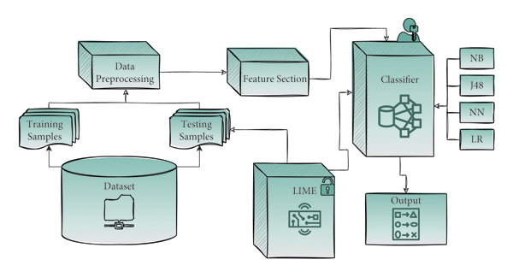
High Level Design : LIME

Slide 11
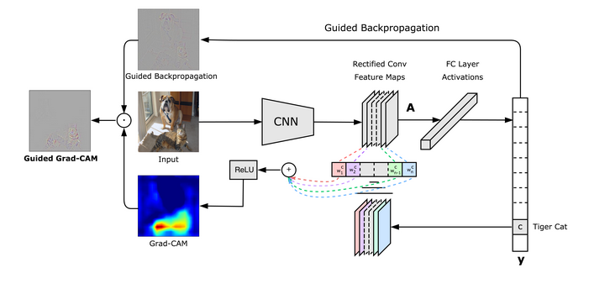
Workflow Design : GRADCAM

Slide 12
Algorithm 1 : LIME
Image Selection:
Choose a specific image processed by the CNN for explanation.
Perturbation and Sampling:
Perturb the image pixels to create a diverse dataset capturing local variations.
Model Prediction Labels:
Pass perturbed images through the CNN to obtain predictions, serving as labels.
Interpretable Proxy Model:
Train a simple, interpretable model on perturbed images to approximate CNN behavior locally.
Feature Importance and Explanation:
Extract feature importance weights from the proxy model to explain influential regions in the image, providing local interpretability.

Slide 13
Algorithm 2 : GRADCAM
Forward Pass:
Gradient Calculation:
Global Average Pooling (GAP):
Weighted Sum:
Grad-CAM Overview:
Forward Pass and Feature Maps:
Gradient Calculation:
Weighted Sum and Activation:
Visualization:

Slide 14
Experimental Setup
Dataset used – Custom Medical Video MRI Dataset comprising of two folders of manually segmented images [I.E.- VM/NOT-VM]
The types of experiments done – LIME-XAI / GRADCAM-XAI

Slide 15
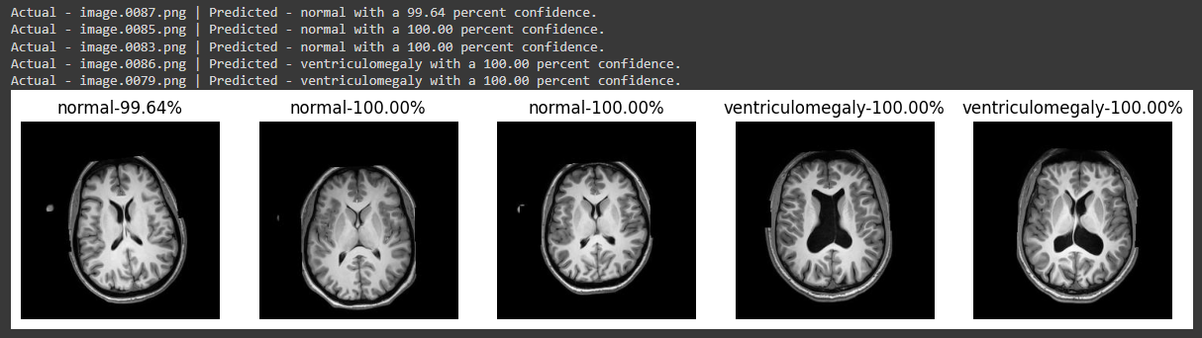
Experiments and Results
CNN classification model

Slide 16
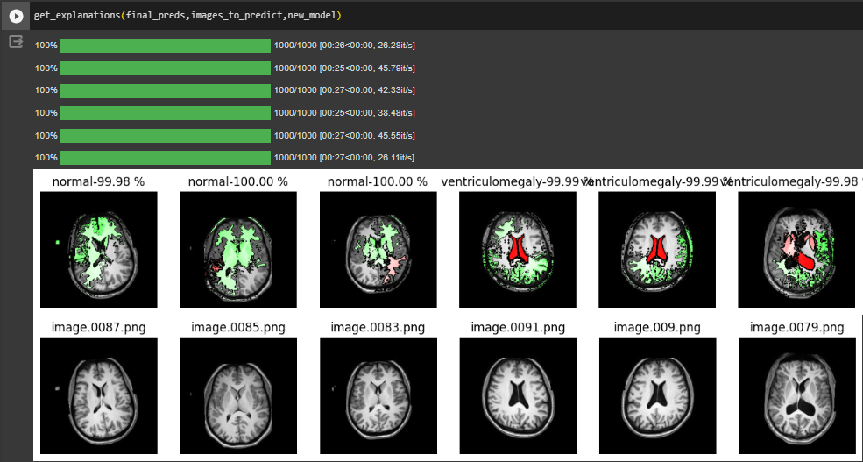
Experiments and Results
LIME-XAI model

Slide 17
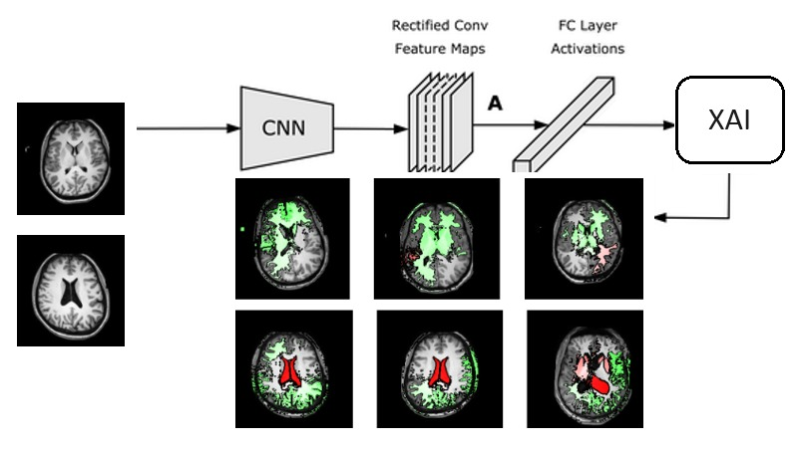
Dataset implementation on High level design

Slide 18
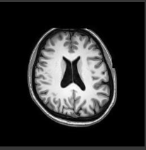
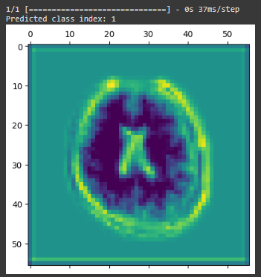
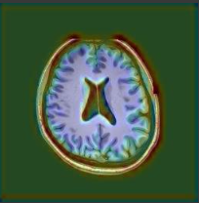
Experiments and Results
GRADCAM-XAI model
Original image Heatmap Superimposed image

Slide 19
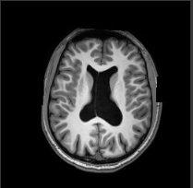
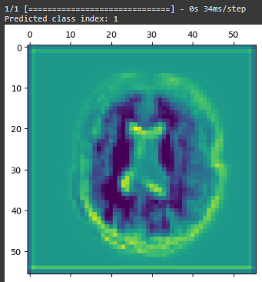
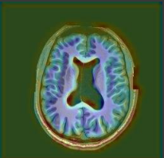
Experiments and Results
GRADCAM-XAI model
Original image Heatmap Superimposed image

Slide 20
Findings
LIME –
Finding – LIME may reveal biases in the model by showing which features the model relies on for predictions.
Inference - This can be important in ensuring that the model is not making predictions based on irrelevant information.
Finding - LIME generates local, instance-specific explanations. For each image, you'll get an explanation of why the model made a particular prediction.
Inference - This can be crucial for clinicians to verify whether the model is focusing on clinically relevant features.
Finding - LIME helps visualize the local decision boundaries around a particular instance.
Inference - Examining these boundaries can reveal how slight variations in the input features influence the model's output.

Slide 21
Findings
GRADCAM-
Finding - Quantify the contribution of different regions by analysing the pixel values in the Grad-CAM heatmap.
Inference - This can help prioritize and rank the importance of different areas in the image.
Finding - The attention maps generated by Grad-CAM visualize the intensity of the model's focus on different parts of the image
Inference - Examining these maps can reveal whether certain regions, such as the ventricles, are consistently attended to by the model
Finding - Grad-CAM helps distinguish between similar classes by emphasizing different regions.
Inference - The model can capture subtle differences between classes, enhancing its potential utility in nuanced medical classifications.

Slide 22
State the practical implications
LIME :
Model Debugging:
Implication: LIME helps identify instances where a model might be making unexpected or incorrect predictions.
Application: Debugging models becomes more efficient, leading to improved overall performance.
User Trust and Adoption:
Implication: Providing understandable explanations for individual predictions enhances user trust in AI systems.
Application: Users, including clinicians and end-users, are more likely to adopt and trust models when they can comprehend and verify the reasoning behind predictions.
Model Selection and Validation:
Implication: LIME allows for the comparison of different models by providing interpretable insights into their decision-making.
Application: Researchers and practitioners can use LIME to choose models that align better with domain requirements or to validate the performance of existing models.
Bias Detection and Mitigation:
Implication: LIME helps uncover biases by highlighting features that significantly influence predictions.
Application: Detection of biased behaviour can prompt adjustments in the training data or model architecture to mitigate biases and enhance fairness.

Slide 23
State the practical implications
Grad-CAM :
Precision in Surgical Planning:
Implication: Grad-CAM helps surgeons precisely identify areas of interest in medical images.
Application: Surgeons can use Grad-CAM to plan procedures with a high degree of precision, focusing on specific regions that the model deems critical for diagnosis.
Personalized Treatment Strategies:
Implication: Grad-CAM can reveal patient-specific patterns in medical images.
Application: In healthcare, personalized treatment plans can be developed by understanding how a model interprets images for individual patients.
Quality Control in Imaging Devices:
Implication: Grad-CAM can be applied to assess the output of medical imaging devices.
Application: By highlighting regions of interest, it helps ensure the quality and accuracy of imaging equipment, contributing to better patient care.
Understanding Model Biases in Imaging:
Implication: Grad-CAM can reveal biases in the model's attention across different demographic groups.
Application: This understanding is critical for mitigating biases and promoting fairness in AI applications, particularly in healthcare.

Slide 24
Conclusion
Originality and Uniqueness:
Our project addresses the potential inaccuracies in manual detection of ventriculomegaly (VM), offering a toolkit for faster and unbiased diagnosis.
Introduces an explanation-centric AI approach in healthcare, providing transparent and understandable insights, setting a new standard in medical AI.
Proposes innovative techniques to quantify and mitigate biases in the model's attention mechanisms, ensuring fairness and ethical considerations are integral to the technical framework.
Current Limitations:
Faces persistent dataset challenges due to privacy commitments and the rarity of the disease.
Acknowledges the absence of a deep learning algorithm for ventricle size measurement from segmentation masks in the classification model.
Future Scope:
Aim to enhance accuracy in XAI models through refined training on discrete datasets for improved classification, segmentation, and project explainability.
Envision an improved classification model incorporating ventricle size measurement through advanced masking techniques.

Slide 25
References
Xie HN, Wang N, He M, Zhang LH, Cai HM, Xian JB, Lin MF, Zheng J, Yang YZ. Using deep-learning algorithms to classify fetal brain ultrasound images as normal or abnormal. Ultrasound Obstet Gynecol. 2020 Oct;56(4):579-587. doi: 10.1002/uog.21967. PMID: 31909548.
Vahedifard, F.; Ai, H.A.; Supanich, M.P.; Marathu, K.K.; Liu, X.; Kocak, M.; Ansari, S.M.; Akyuz, M.; Adepoju, J.O.; Adler, S.; et al. Automatic Ventriculomegaly Detection in Fetal Brain MRI: A Step-by-Step Deep Learning Model for Novel 2D-3D Linear Measurements. Diagnostics 2023, 13, 2355. https://doi.org/10.3390/diagnostics13142355
Sira LB, Kozyrev DA, Bashat DB, Constantini S, Roth J, Shiran SI. Fetal Ventriculomegaly and Hydrocephalus – What Shouldn't be Missed on Imaging?. Neurol India 2021;69, Suppl S2:298-304
N. Siddique, S. Paheding, C. P. Elkin and V. Devabhaktuni, "U-Net and Its Variants for Medical Image Segmentation: A Review of Theory and Applications," in IEEE Access, vol. 9, pp. 82031-82057, 2021, doi: 10.1109/ACCESS.2021.3086020.
O. Attallah, H. Gadelkarim and M. A. Sharkas, "Detecting and Classifying Fetal Brain Abnormalities Using Machine Learning Techniques," 2018 17th IEEE International Conference on Machine Learning and Applications (ICMLA), Orlando, FL, USA, 2018, pp. 1371-1376, doi: 10.1109/ICMLA.2018.00223.

Slide 26
Link to the Project Demo

